Slide 1


Notes:
<number>

Slide 2
The Problem

Slide 4
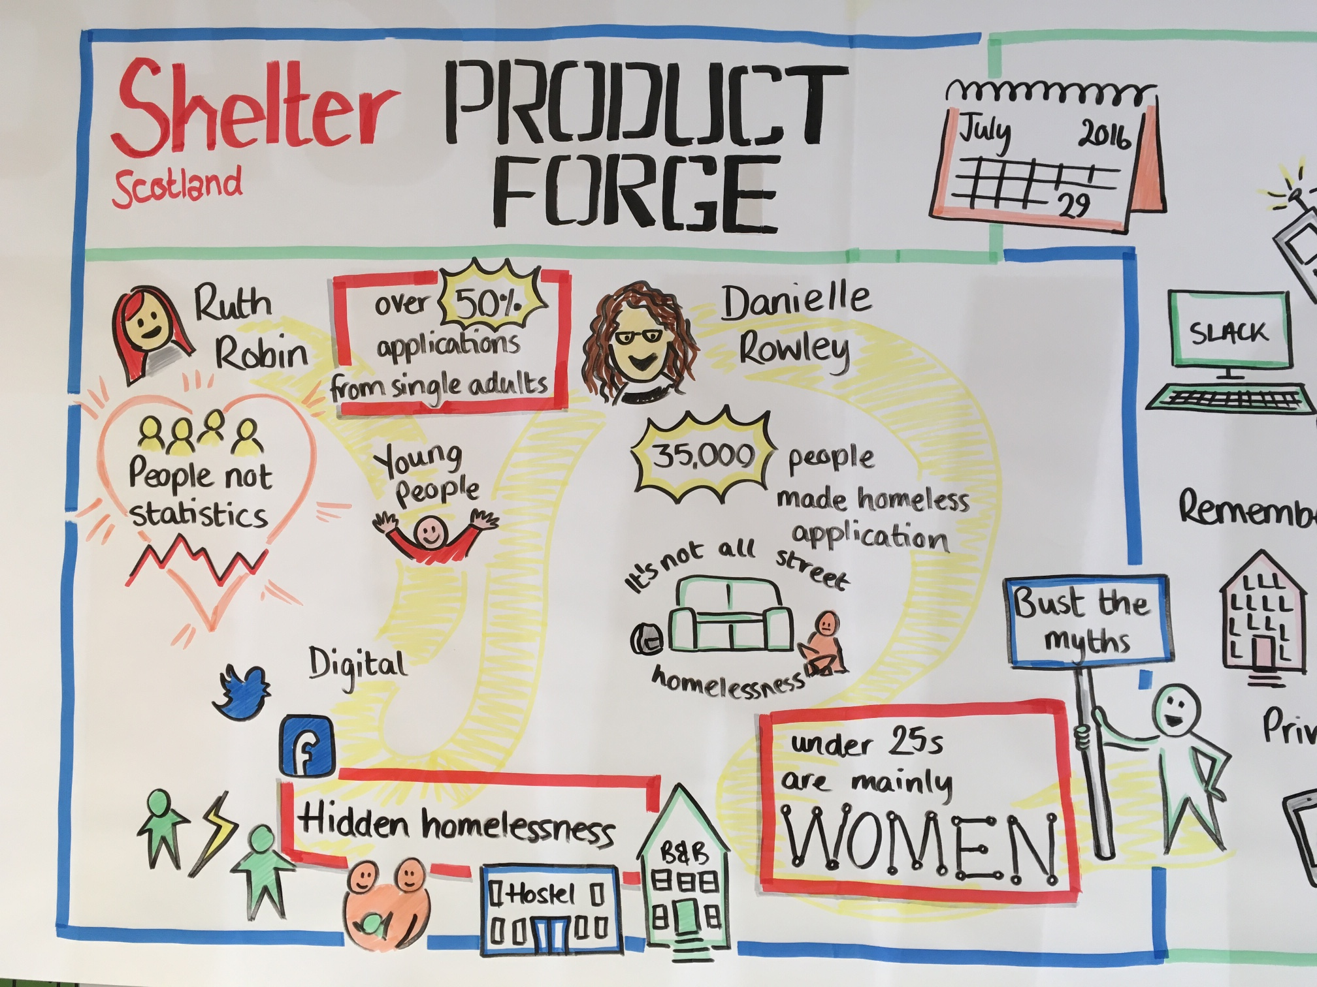
How can this be done better

Slide 5
Web demo

